Slide 2

From Industrial Symbiosis to Human-Centric Energy Communities:
Scaling Innovation from Sirkulære Kaupanes and the COPPER Project
By: Rolf Andre Leidland
Project manager Eigersund Næring og Havn
Notes:
• "Good afternoon, everyone.
My name is Rolf Andre Leidland, and today I'll be presenting on a journey from industrial symbiosis to human-centric energy communities.
We'll explore how we are scaling innovations from two interconnected projects: Sirkulære Kaupanes in Norway and the transnational DUT project, COPPER.
• "This work is a collaborative effort, involving researchers, municipalities, and industry partners across four countries, all aiming to make Positive Energy Districts a European reality.«
Denmark
The Netherlands
Norway
Portugal

Slide 3
Where?
The Projects' Geographical Footprint
Today's Focus:
Norway
Eigersund
Sirkulære Kaupanes
Notes:
• "To set the scene, the COPPER project is a transnational initiative, studying PEDs in various stages across Norway, Portugal, the Netherlands, and Denmark. This diversity allows us to stress-test our approaches under different climatic, institutional, and cultural conditions."
• "Our focus today is the Norwegian case: Sirkulære Kaupanes, located on the island of Eigerøy. This is an industrial area facing a critical challenge: an overloaded power grid that is hindering new, green industrial growth. A company like Norwegian King Prawns, for example, cannot establish itself due to this energy bottleneck."
• "The vision for Kaupanes, building on learnings from the H2020 ROBINSON project, is to become a CO2-negative energy hub. Within COPPER, this industrial setting provides a unique opportunity to apply principles of citizen-led energy communities to an industrial context, moving beyond the typical residential focus."

Slide 4
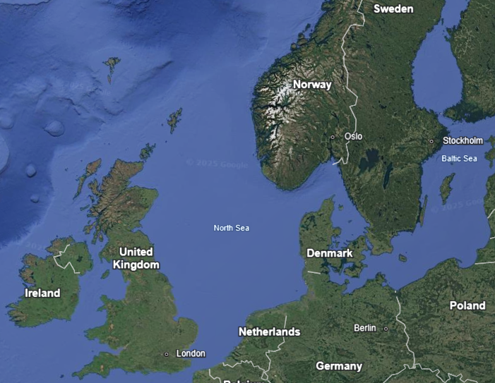
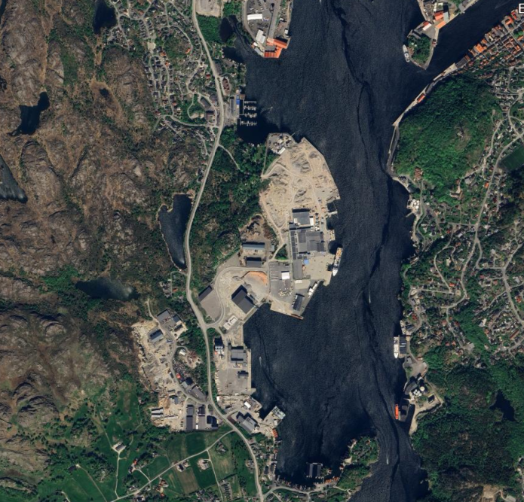
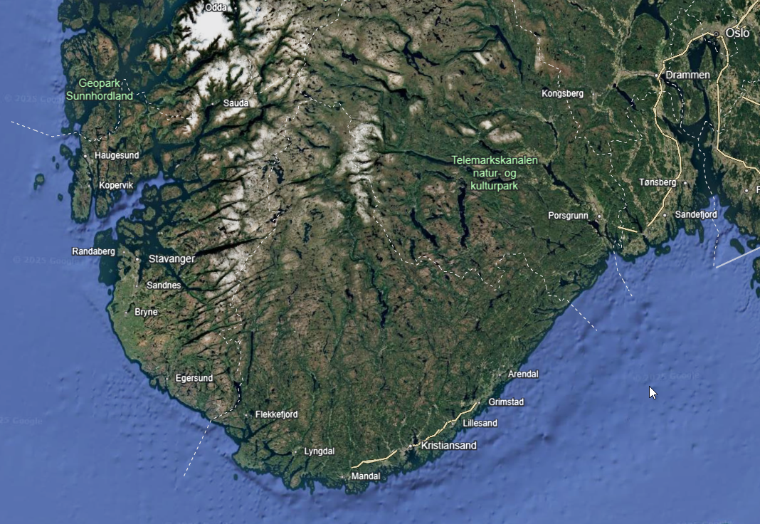
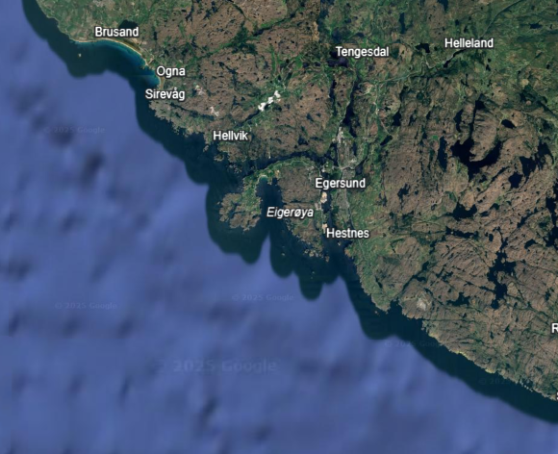

Slide 5
Where?
The Projects' Geographical Footprint
Today's Focus: Norway – Sirkulære Kaupanes, Eigersund.
Context: Kaupanes is an industrial area on Eigerøy, an island where an overloaded power grid limits the establishment of new industries.
Vision: To transform the area into a self-sufficient and CO2-negative energy hub through industrial symbiosis, building on experiences from the H2020 project ROBINSON.
Link to COPPER: Sirkulære Kaupanes serves as a Norwegian case for exploring how principles of energy communities and citizen engagement can be applied in an industrial context.
Notes:
• "To set the scene, the COPPER project is a transnational initiative, studying PEDs in various stages across Norway, Portugal, the Netherlands, and Denmark. This diversity allows us to stress-test our approaches under different climatic, institutional, and cultural conditions."
• "Our focus today is the Norwegian case: Sirkulære Kaupanes, located on the island of Eigerøy. This is an industrial area facing a critical challenge: an overloaded power grid that is hindering new, green industrial growth. A company like Norwegian King Prawns, for example, cannot establish itself due to this energy bottleneck."
• "The vision for Kaupanes, building on learnings from the H2020 ROBINSON project, is to become a CO2-negative energy hub. Within COPPER, this industrial setting provides a unique opportunity to apply principles of citizen-led energy communities to an industrial context, moving beyond the typical residential focus."

Slide 6
Who?
The Stakeholders and Their Roles
The COPPER Consortium:
  8 partners
  4 countries
Notes:
• "So, who is making this happen? The COPPER consortium is a transdisciplinary team of 8 partners, including universities and research institutes like Radboud, Aalborg, ISCTE and Ruralis, alongside municipalities and businesses."

Slide 7
Who?
The Stakeholders and Their Roles
The Sirkulære Kaupanes Network: An expanded collaboration led by Eigersund Næring og Havn
Energy Suppliers (Surplus Heat)
Energy Consumers/Recipients
Key Partners
Notes:
• "Zooming in on Sirkulære Kaupanes, the network is even broader. Led by Eigersund Næring og Havn, it brings together key industrial players. We have energy suppliers—like Prima Protein and Pelagia—who currently have vast amounts of unutilized surplus heat. And we have energy recipients, like the planned Norwegian King Prawns and Bertelsen & Garpestad, who need that energy."
• "The key innovation here is the collaborative model. We are moving away from a traditional system where companies are just passive customers. Instead, we are creating an energy community where they become active participants in the energy flow, co-creating and sharing value. This is supported by crucial expertise from partners like Dalane Energi, PX Group, and research institutions like Ruralis, NORCE and UiS.«
The Sirkulære Kaupanes Network: An expanded collaboration led by Eigersund Næring og Havn (ENH).
Energy Suppliers (Surplus Heat): Prima Protein, Pelagia, Dalane Hydrogen.
Energy Consumers/Recipients: Norwegian King Prawns (a new establishment dependent on the solution), Bertelsen & Garpestad (concrete production).
Key Partners: Dalane Energi (expertise), PX Group (circular economy), and research institutions like Ruralis, NORCE, and the University of Stavanger.
Role Allocation: A model where companies are active participants in the energy flow, not just passive customers.

Slide 8
What?
The Core Challenge and Research Question
Overarching Challenge (COPPER):
How can we strengthen the role of citizens in energy communities to create human-centric PEDs, while simultaneously addressing societal, energetic, and governance challenges?.
Notes:
• "At its core, COPPER addresses a fundamental challenge: how do we empower citizens, especially vulnerable groups, to take an active role in the energy transition?. We know that top-down, technocratic approaches often fail because they don't connect with people's lived experiences."
• "In Sirkulære Kaupanes, this translates into three concrete problems: an overloaded grid, wasted resources in the form of surplus heat, and the need for a new way to collaborate. The risk of doing nothing is economic stagnation and continued environmental impact."
• "This brings us to our key research question for today's session on Urban Regeneration: How can we develop scalable governance and business models for industrial energy communities that balance technical efficiency with inclusive and just urban regeneration?. This question is vital if we want to make PEDs a widespread European practice."

Slide 9
What?
The Core Challenge and Research Question
Specific Challenge (Sirkulære Kaupanes):
  Energy: An overloaded power grid on Eigerøy hinders industrial growth.
  Resources: Large amounts of unutilized surplus heat and high CO2 emissions from existing industries.
  Collaboration: How to organize an energy community in an industrial setting to create shared value and sustainable growth?.
Notes:
• "In Sirkulære Kaupanes, this translates into three concrete problems: an overloaded grid, wasted resources in the form of surplus heat, and the need for a new way to collaborate. The risk of doing nothing is economic stagnation and continued environmental impact."

Slide 10
What?
The Core Challenge and Research Question
Research Question:
How can we develop scalable governance and business models for industrial energy communities that balance technical efficiency with inclusive and just urban regeneration?.
Notes:
• "At its core, COPPER addresses a fundamental challenge: how do we empower citizens, especially vulnerable groups, to take an active role in the energy transition?. We know that top-down, technocratic approaches often fail because they don't connect with people's lived experiences."
• "In Sirkulære Kaupanes, this translates into three concrete problems: an overloaded grid, wasted resources in the form of surplus heat, and the need for a new way to collaborate. The risk of doing nothing is economic stagnation and continued environmental impact."
• "This brings us to our key research question for today's session on Urban Regeneration: How can we develop scalable governance and business models for industrial energy communities that balance technical efficiency with inclusive and just urban regeneration?. This question is vital if we want to make PEDs a widespread European practice."

Slide 11
Solutions Under Development
COPPER's Approach: Developing a "communication ecology" to understand and improve how citizens navigate their technological, social, and discursive environment to participate in the energy transition. This includes:
Peer-to-peer (P2P) platforms for citizens (WP2).
Modeling of energy systems and governance rules (WP3).
Innovative governance models that integrate energy and spatial planning (WP4).
Notes:
• "To tackle these challenges, COPPER is developing what we call a 'communication ecology'. This is a framework for understanding how citizens access and use information to participate in the energy transition. It’s not just about technology; it’s about the interplay between a technological layer (like P2P platforms), a social layer (the networks of people), and a discursive layer (the stories we tell about energy)."

Slide 12
Solutions Under Development
Sirkulære Kaupanes' Solution:
A physical Energy Hub: Integrates surplus heat, solar, biogas, and hydrogen to produce, store, convert, and distribute energy locally.
An organizational Energy Community: Establishes a new entity (e.g., a limited company or cooperative) to operate the hub, with profits reinvested in research and innovation.
Goals: Reduce CO2 emissions, relieve the power grid, and enable sustainable industrial growth.
Notes:
"In Sirkulære Kaupanes, this framework comes to life. We are developing a physical Energy Hub to produce, store, and distribute energy from sources like industrial surplus heat, solar, and hydrogen. But just as importantly, we're establishing an organizational Energy Community—a formal body like a cooperative or company—that will operate the hub. The goal is to reinvest profits back into local innovation, creating a self-sustaining ecosystem for green growth."

Slide 13
Urban Regeneration
- What is Ready to Scale?
Ready to Scale:
  The Industrial Energy Community Model
  Integrated Planning
  Citizen Engagement Through Events
Notes:
• "In line with this afternoon's theme of overcoming challenges, I want to highlight what we believe is ready for scaling today."
• "First, the industrial energy community model. Sirkulære Kaupanes proves that the toolkit for energy communities can be adapted from residential areas to industrial parks. This is a replicable strategy for any region looking to boost sustainability and competitiveness."
• "Second, our approach to integrated planning. The way we are linking strategic energy planning from COPPER's Work Package 4 with the hands-on business and area development in Eigersund is a powerful combination that other cities can adopt."
• "And third, a concrete tool for engagement: the Energy Festival. We are planning this for June 21st in Eigersund, targeting schoolchildren and families to make a complex topic like energy transition accessible and engaging. This format, inspired by similar events in our Dutch case, is a scalable way to build the social foundation for PEDs."

Slide 14
Urban Regeneration
- What Needs Further Innovation?
Needs Further Innovation:
  Governance Models for Value Sharing
  Inclusion of Vulnerable Groups in Tech-Heavy Projects
  Balancing Inclusivity with Commercial Speed
Notes:
• "While some solutions are ready, others require more work. This is where the 'remaining challenges' part of our session comes in."
• "First, governance models for value sharing. How do you fairly distribute profits and risks among diverse industrial partners with different bottom lines? We need new legal and organizational frameworks that go beyond simple energy sales to create shared, long-term value."
• "Second, inclusion of vulnerable groups in tech-heavy industrial projects. COPPER has a strong focus on energy poverty and vulnerability. But how does an industrial project like Sirkulære Kaupanes benefit those who are not directly employed? We need to innovate to ensure the social benefits of urban regeneration reach the entire community, not just the industrial players."
• "Finally, we must balance inclusivity with commercial speed. Deep stakeholder engagement, which is central to the COPPER philosophy, takes time. In the industrial world, momentum is everything. We need innovative methods for co-creation that are efficient and don't stall commercial progress. This is a critical challenge for scaling PEDs in real-world business environments."

Slide 15
Summary and The Way Forward
Sirkulære Kaupanes: a concrete example of how the theoretical framework can be applied to create sustainable urban and industrial regeneration.
Notes:
"To summarize, Sirkulære Kaupanes is a living lab where the human-centric principles of the COPPER project are being put into practice in a demanding industrial environment."

Slide 16
Summary and The Way Forward
Key Learning:
Success depends on building a robust communication ecology that connects technical solutions with social structures and shared narratives.
Sustainability as a competitive advantage
Notes:
"Our key takeaway is that success hinges on building a robust communication ecology. It's the synergy between the hardware of the energy hub and the software of the energy community, all bound together by a shared story of sustainability as a competitive advantage."

Slide 17
Summary and The Way Forward
Next Steps:
Secure financing and establish the formal organization for Sirkulære Kaupanes.
Use insights from COPPER to develop and test the new governance models that require further innovation.
Share learnings through COPPER's dissemination channels, including webinars and policy recommendations, to accelerate the implementation of PEDs across Europe.
Notes:
"Our next steps are clear. For Sirkulære Kaupanes, it's about formalizing the organization and securing investment. For COPPER, it's about using the insights from all our case studies to refine those innovative governance models. And crucially, it's about sharing these learnings widely, through our partners like REScoop Europe, to help achieve the mission of 100 PEDs across the continent."

Slide 18
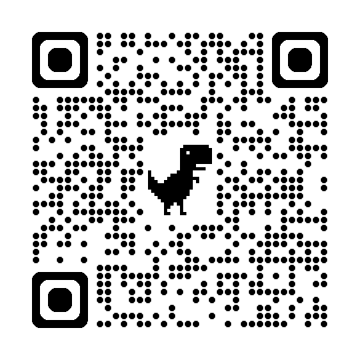
Thank You & Questions
COPPER Project Website: https://ruralis.no/en/projects/creating-optimizing-and-planning-positive-energy-districts-connecting-citizens-energy-at-different-geographical-levels/
Sirkulære Kaupanes: Rolf André Leidland / Klaudia Teresa Tolstow]
Notes:
• "Thank you for your attention. I hope this has provided a clear view of both our achievements and the challenges we are actively working to overcome. I look forward to your questions and the discussion."

